Slide 1
Motion Magnification
Supervisor: Dr. Rajendra Nagar Bhavya Manish Sharma(B20EE013) Academic Year: 2021-2022 Dhruv(B20EE016)
Semester : 1
Course Number : EEN1010
Date of Presentation: 29-11-2019

Slide 2
Motivation
Implement a method to observe motions too small to be well perceived by the naked eye.
A method that computationally amplifies the subtle motions to reveal them.
To develop a method of motion magnification that supports larger magnification factors and does not amplify the noise.
To come up with a method that accurately provides motion estimation.
An approach that manipulates motion in videos by analyzing the signals of local phase over time in different spatial scales and orientations.

Slide 3
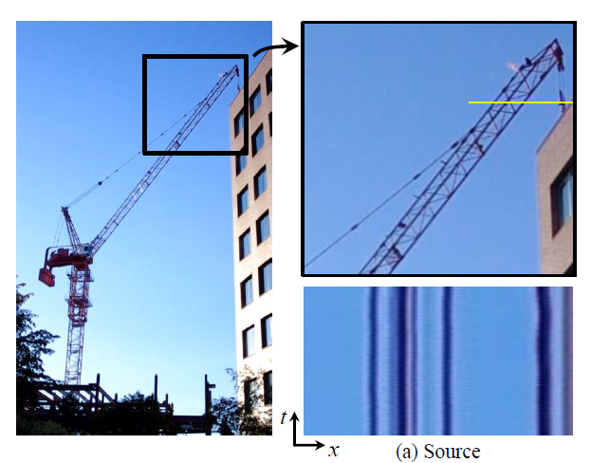
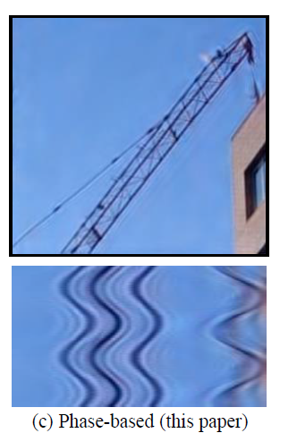
Objectives and Targeted Deliverables
OBJECTIVES :
To demonstrate the advantages on synthetic and natural video sequences
Explore applications in scientific analysis, visualization and video enhancement.
Demonstrate that this method can achieve larger motion magnifications with fewer artifacts
TARGETED DELIVERABLES:
Implementation of a method for
magnifying invisible motion,
in a video

Slide 4

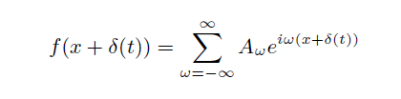



Basic Theory
Motion processing, the case of a 1D image
Finding Fourier Transform
Use DC-balanced Filter to extract phase
Magnify the phase and reconstruct

Slide 5
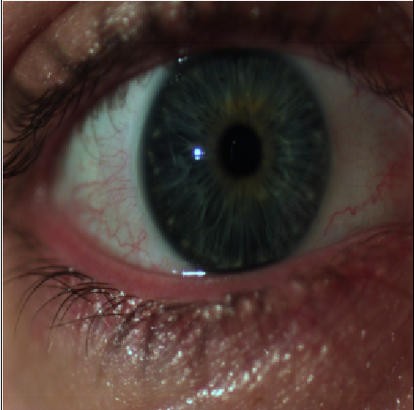
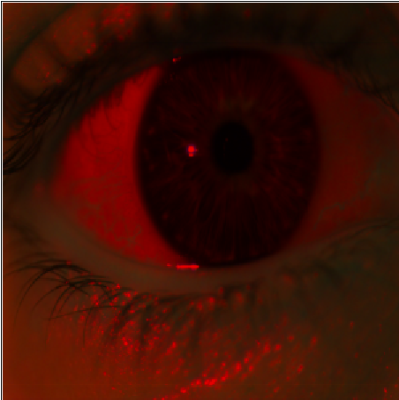
Algorithm and Process
Taking video input and resizing the frames
Input video with 600 frames resized to images with height=width=300.
Converting RGB frames to YIQ frames
RGB images converted to YIQ images
Constructing the complex steerable pyramids
Types:
Octave, Half Octave, Smooth Half Octave, and Quarter Octave

Slide 6
Extracting the phase and removing the dc component
Removed the DC component from the filtered frame
Temporal filtering and amplification of phase
Using temporally filters frames the phase was blurred
Amplified the phase by constant magnifying component.
Reconstructing the video

Slide 7
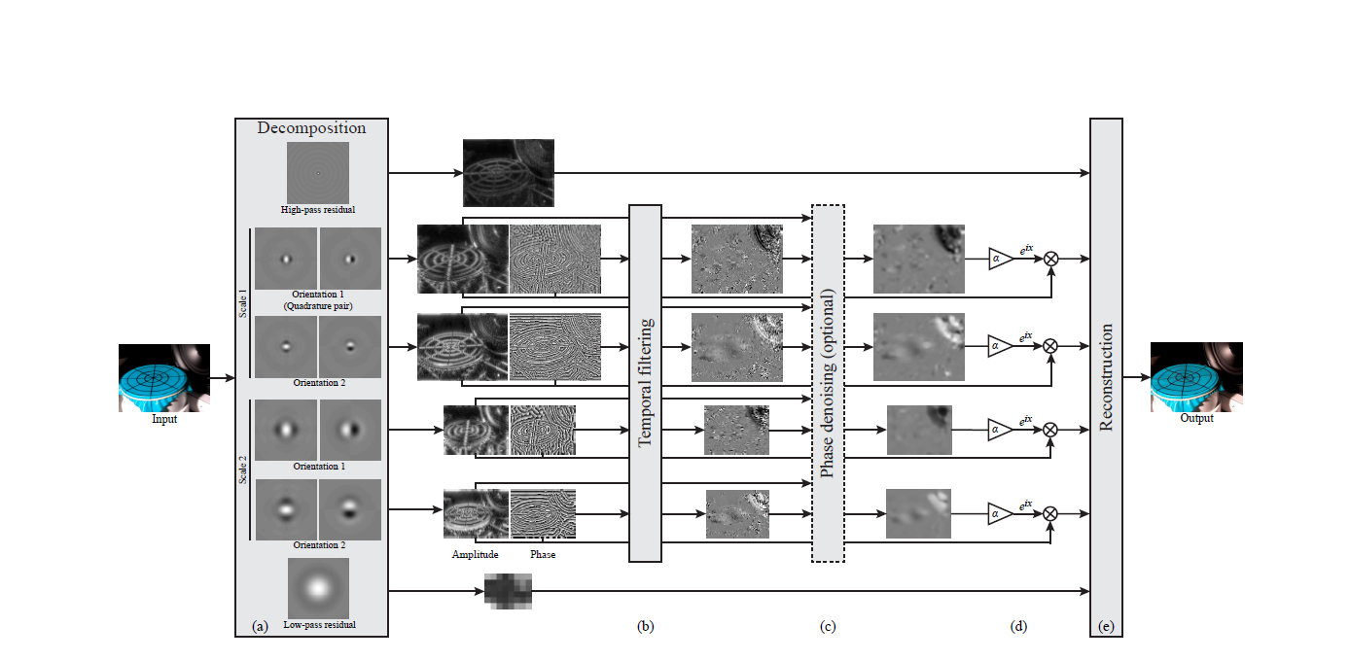

Slide 8
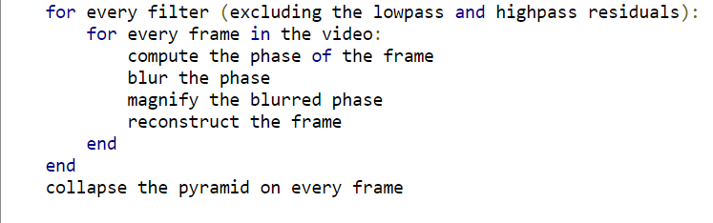
Pseudo Code

Slide 9
Results and Conclusions
Allows users to see small motions without excessive noise
Octave-bandwidth pyramid and 2 orientations this method can be efficiently implemented to run in real time
Supports larger amplification factors and gives a fundamentally better way of handling noise
Quarter octave method works the best followed by smooth half octave

Slide 10
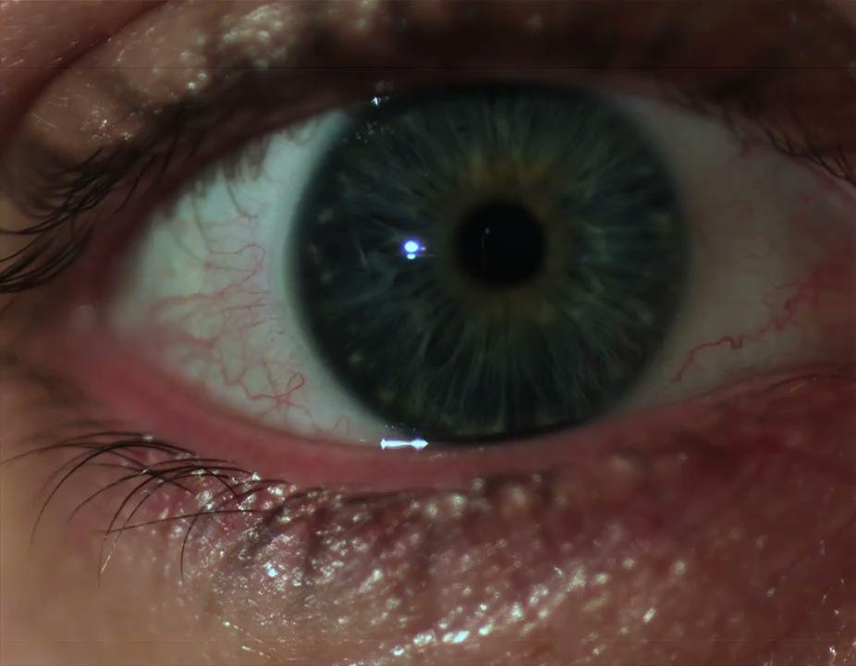
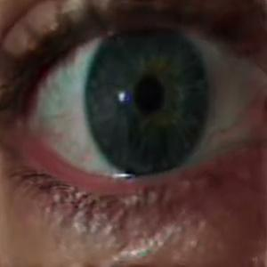
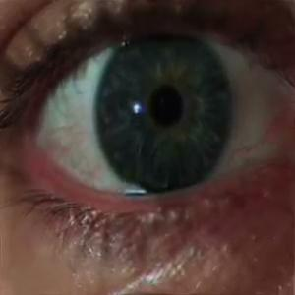
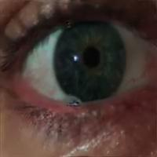
Original
Half Octave
Smooth Half Octave
Quarter Octave
Octave

Slide 11
THANK YOU

